Slide 1

The Impact of COVID-19 on Data Jobs
A project by Marcy Fang, Tisha Conner, Rosanna Chiu, Telmen Erdenebat & Amna Hussain

Slide 2

Our focus
The number of data jobs before and after the COVID-19 pandemic
How many of those jobs are remote or onsite
The number of people employed in data positions
The average wages of those with data jobs before and after the COVID-19 pandemic

Slide 3
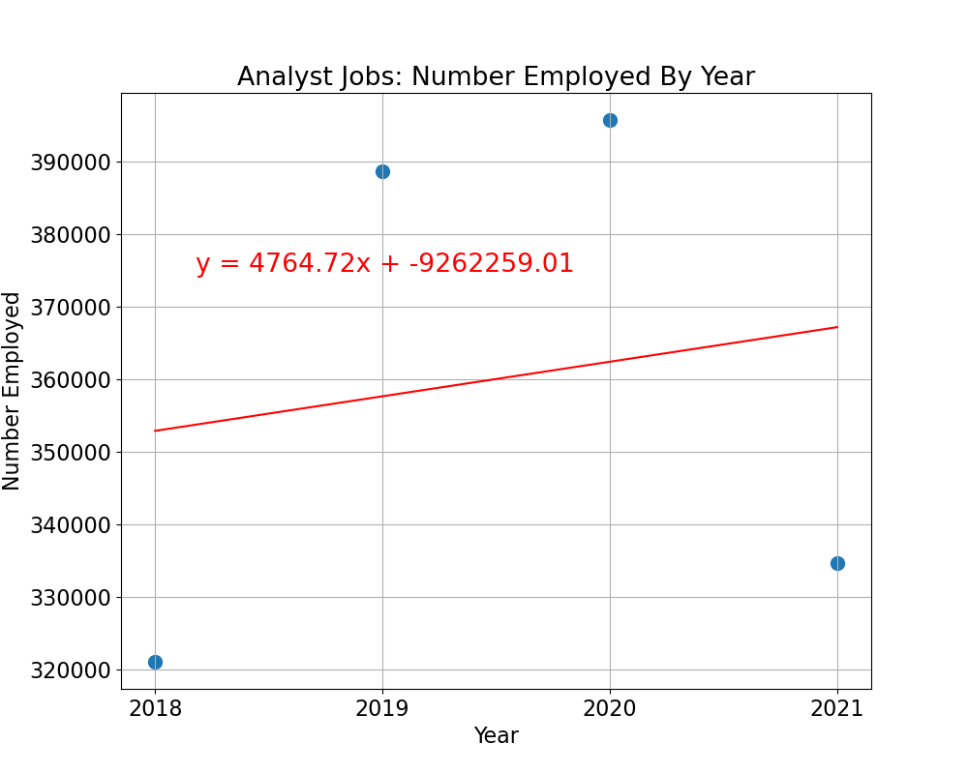
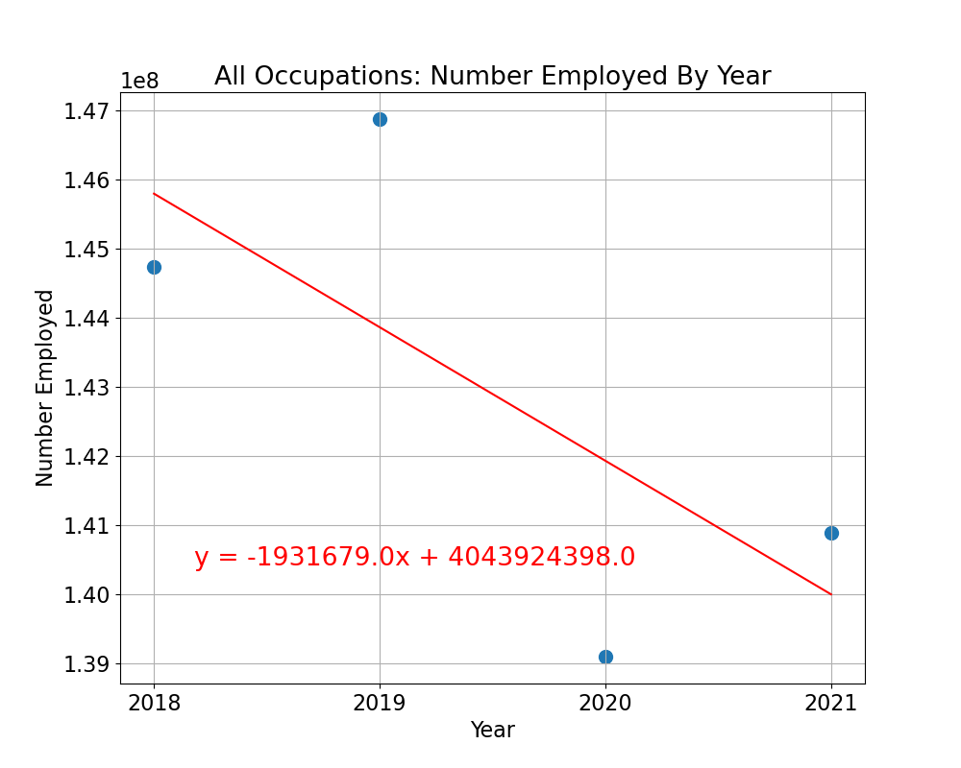
What we found based on the Bureau of Labor Statistics
2021
2020
Trends
Saw a dramatic decrease in the number of employed data analysts
Surprisingly, the highest employed year for data analyst jobs
Strong negative correlation during pandemic of number employed by year in all occupations
68%

Slide 4
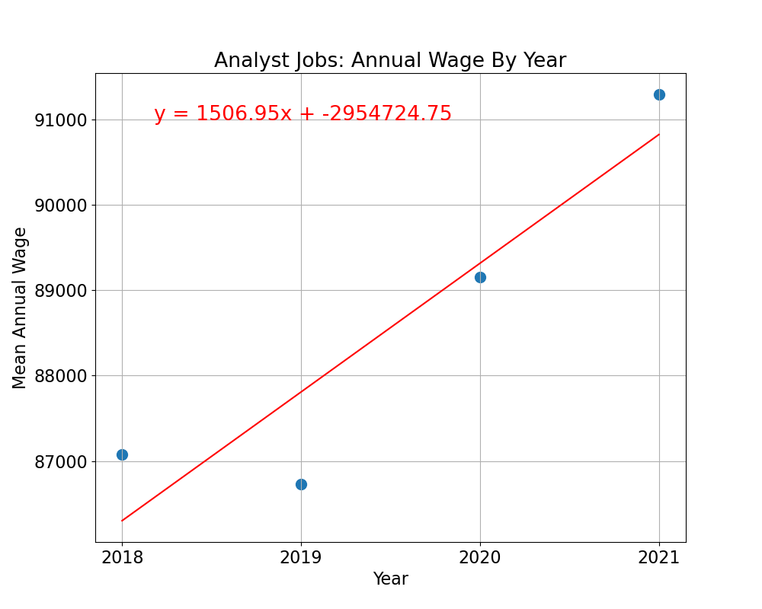
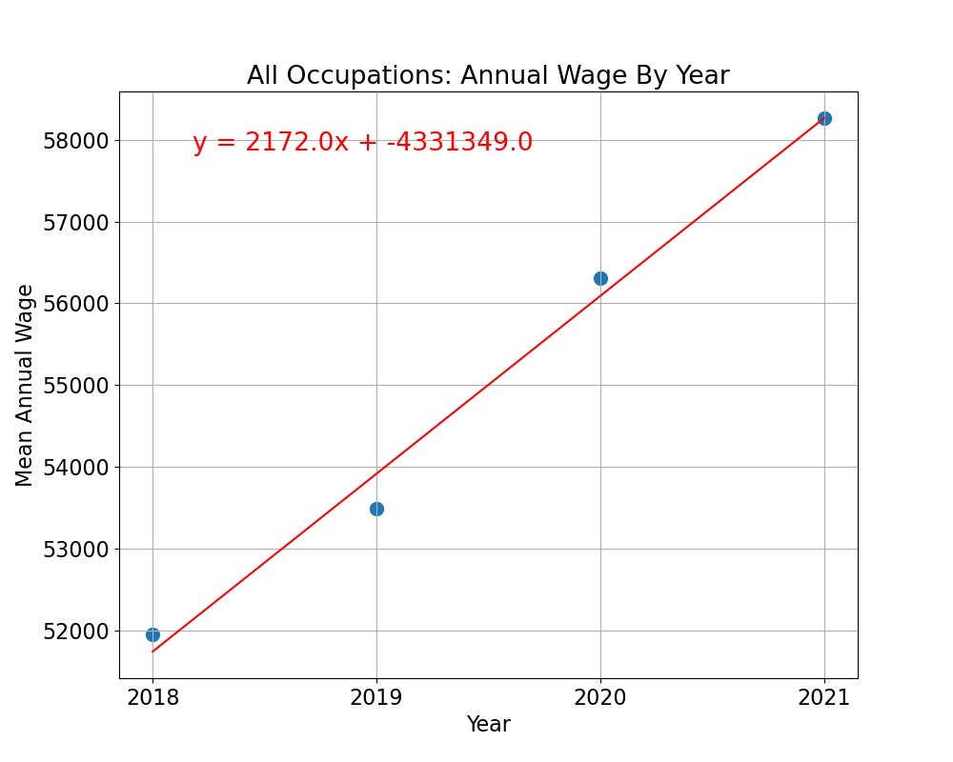
$93k
$86k
Upward Trend
The average annual wages in data jobs and all occupations are presenting a strong positive correlation
At an average, the highest annual wage was $93k in 2021
The lowest mean annual wage was $86k in 2019

Slide 5
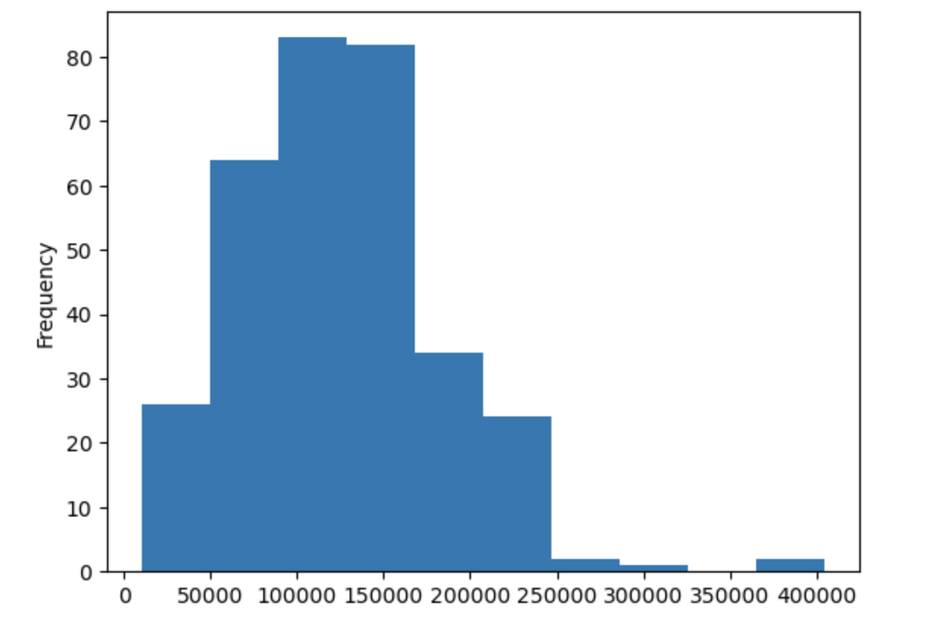
What we found based on Kaggle

Slide 7
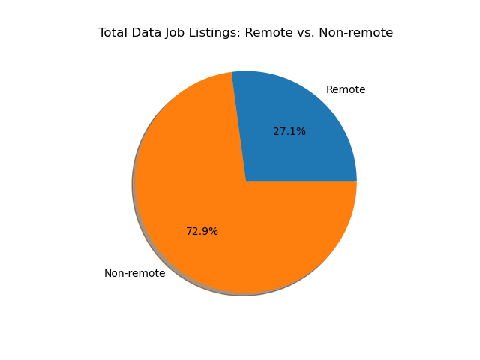
What we found based on Glassdoor
Onsite
Onsite
Current job postings are shifting back to onsite positions after the pandemic.
Remote
Though more remote positions are available compared to before the pandemic, remote positions are still in the minority even in the data field.
Onsite

Slide 8
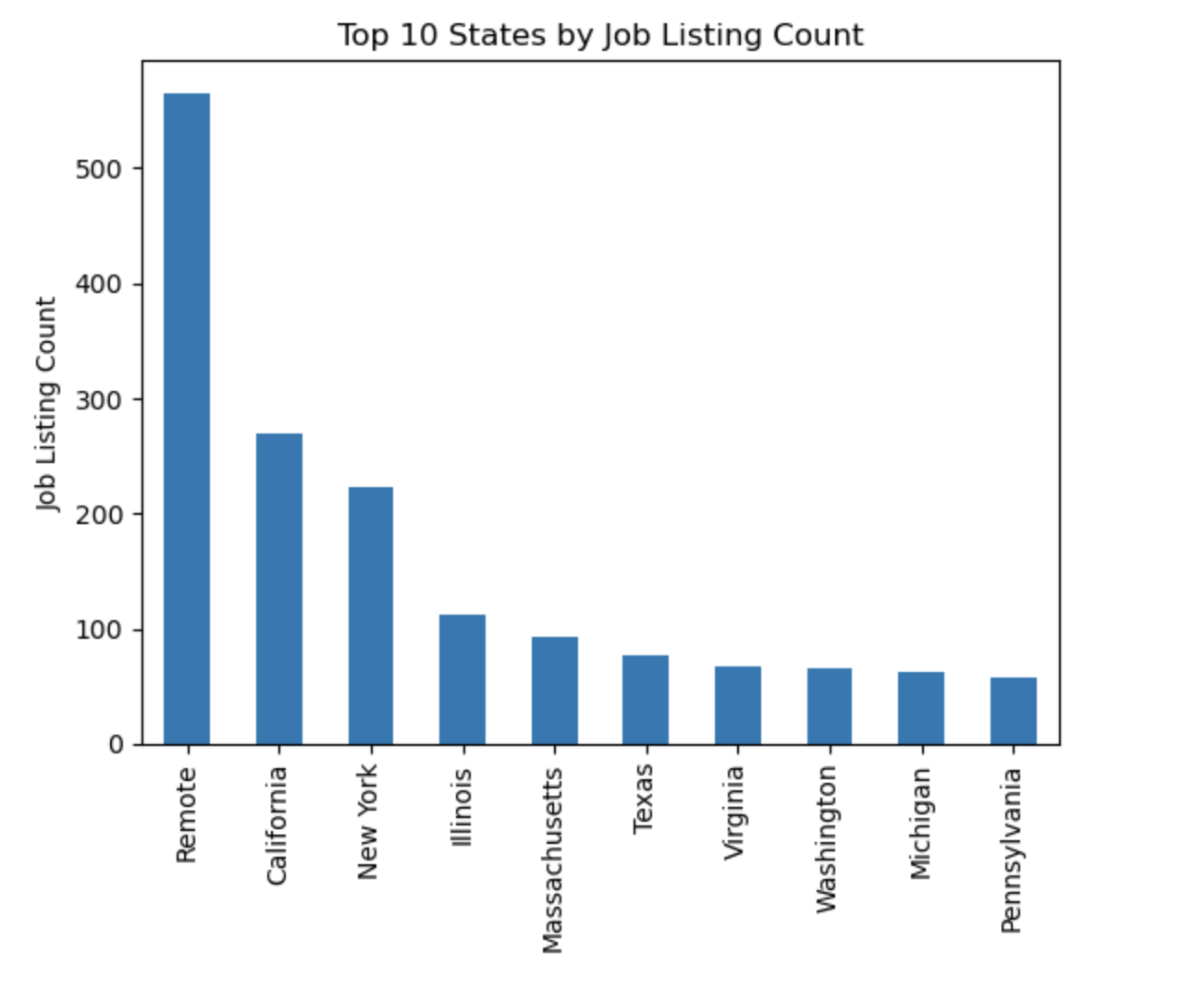
REMOTE
Based on Glassdoor job postings, remote data positions seem to be more prevalent than any other state onsite data positions

Slide 9
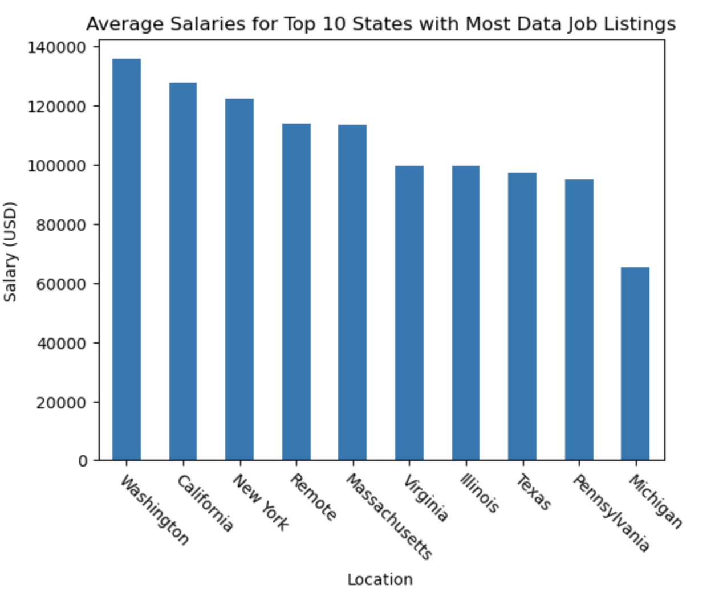
WASHINGTON, despite having fewer data job postings than most states in the top 10, offers a higher salary on average

Slide 10
So what does it all mean?
before
after
COVID -19
Higher employment rate, and higher pay in data field
Fewer jobs and less pay in data
More jobs in other occupations, but less pay
During the pandemic, data jobs were largely unaffected by unemployment
More remote positions available nationwide

Slide 11
We can conclude…
The aftermath of the COVID-19 pandemic increased the number of data jobs and those in the data field, increased the number of remote positions but still primarily require employees to be onsite, and increased the average salary of data analysts.

Slide 12
Questions? Comments?
Let’s hear it!

